Slide 1

Introduction
Lecture 0.1 | CSE421 – Computer Networks
Department of Computer Science and Engineering
School of Data & Science

Slide 2
Objectives
Internet today
Network in our lives
Course outline
Online Learning
Marks Distribution
Books
About CCNA

Slide 3
Internet Applications (2020)
Internet Users
  5.52B users worldwide
  2.92B in Asia
Web
  1.13B – Number of websites (December).
  252,000 new websites created every day
Email
  4.5B people used email
Facebook
  3.07 B users in 2025 December
  60 billion reacts on Facebook every day.
Other Social Media
  600+ m users in Twitter
  500 million of tweets sent every day

Slide 4
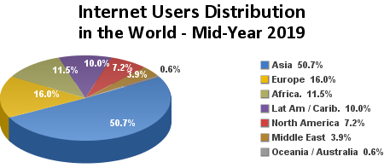

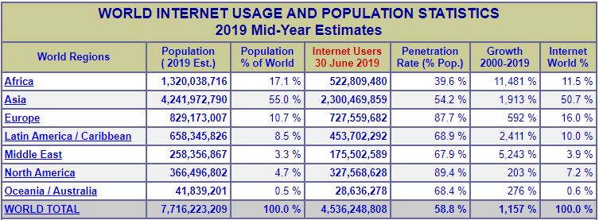
Internet Statistics (2019)

Slide 5
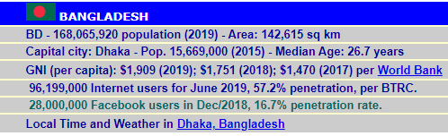
Internet Statistics (2019) - Bangladesh
Source; http://www.internetworldstats.com/

Slide 6
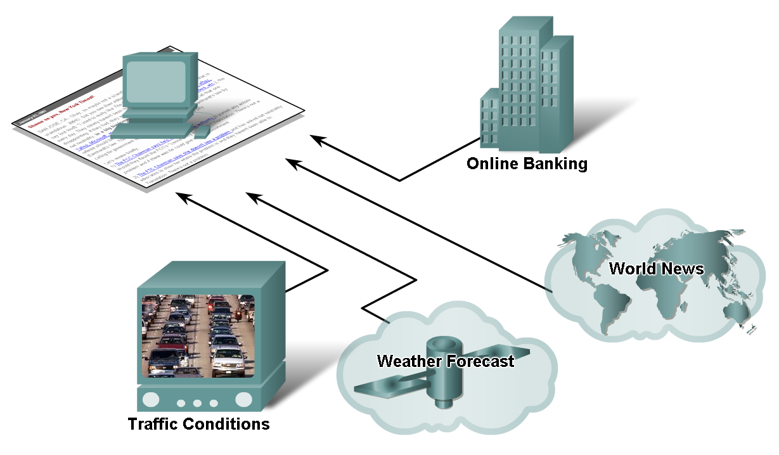
Networks supporting the way we live

Slide 7
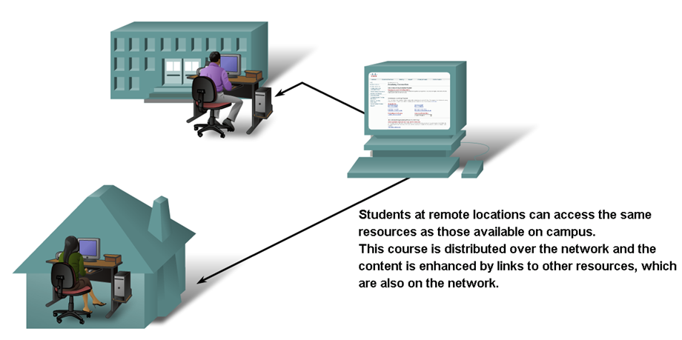
Networks supporting the way we learn

Slide 8
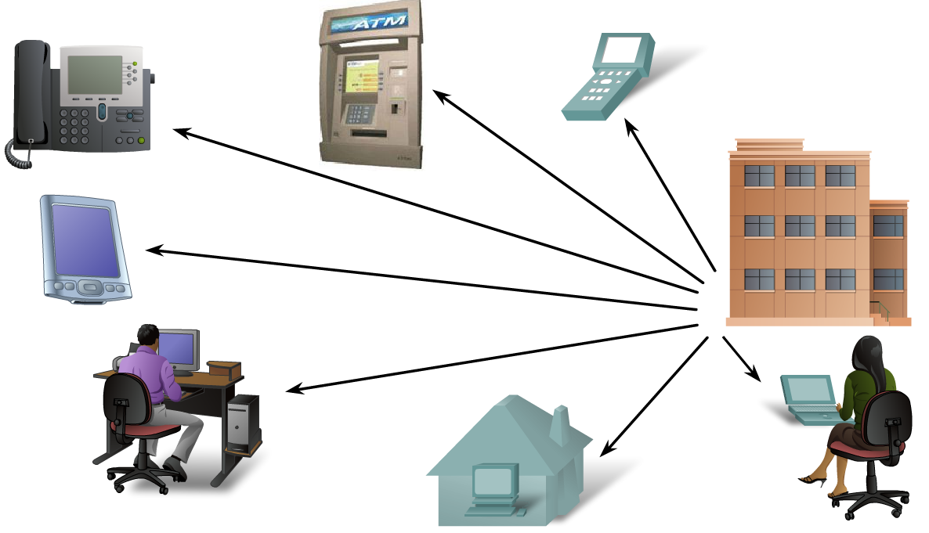
Networks supporting the way we work

Slide 9
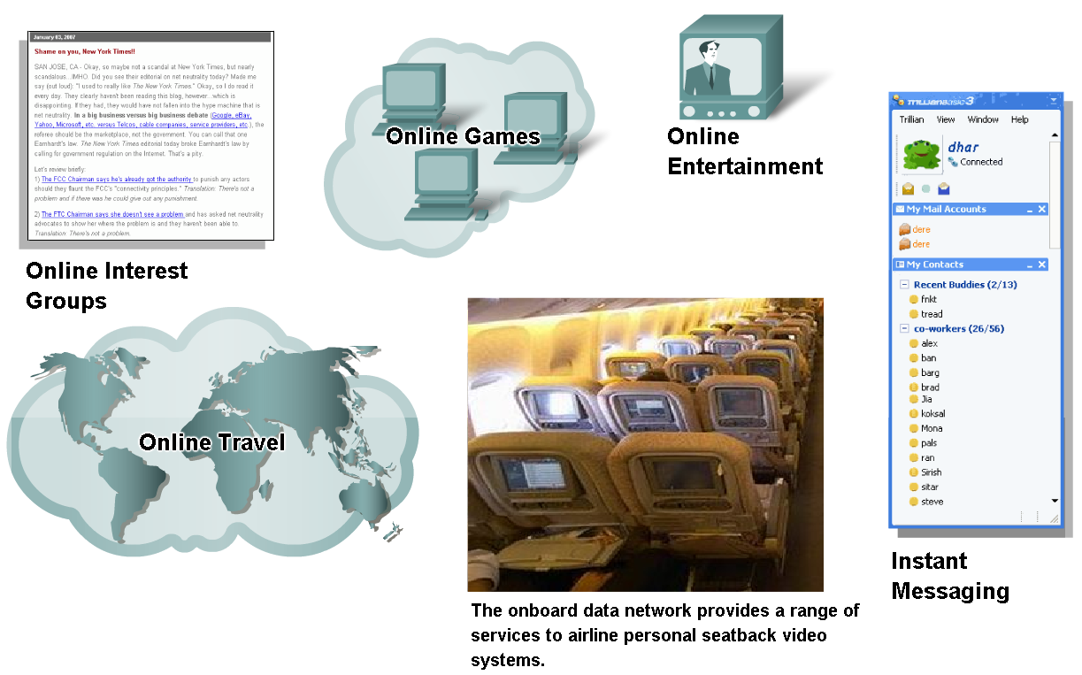
Networks supporting the way we play

Slide 10
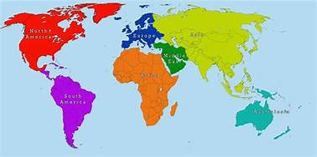



How?

Slide 11
Course Outline
Protocols and Network Architecture [Mid-Term]
  Introduce the concepts of network architectures, topologies, layering and protocols.
Application Layer [Mid-Term]
  Describe key application layer concepts such as network services required by applications, clients and servers.
Transport Layer [Mid-Term]
  Explain transport layer concepts, relationship with the network and application layers, and services such as principles of reliable data transfer and congestion.
Network Layer [Final-Term]
  Teach network layer concepts, routing principles, algorithms, and addressing and Internet’s various protocols.

Slide 12
Course Outline
Data Link Layer [Final-Term]
  Identify link layer services, link layer address and multi-access techniques.
Network Security [Final-Term]
  Teach basic knowledge of the use of cryptography and network security.
Wireless Networks [Final-Term]
  Explain the operation of wireless LANs based on the IEEE802.11 standards, and mobility.
Labs
  Using simulation tools to observe and analyze behaviors of networking protocols.
Outcome
  Design and create a small network for an organization.

Slide 13
Mid-Term Schedule (Tentative)
Date | Day | Topic
09 Jun | Tue | Intro Class
14 Jun | Sun | 1 - Protocols
16 Jun | Tue | 2 - AL - HTTP
21 Jun | Sun | 2 - AL - HTTP
23 Jun | Tue | 3 - AL - Email, DNS
28 Jun | Sun | 4 - TL - Intro and UDP
30 Jun | Tue | 5 - TL - TCP
05 Jul | Sun | 5 - TL - TCP
07 Jul | Tue | 6 - TL - TCP Congestion Control
12 Jul | Sun | 7 - NL - IPv4 & IPv6 Addressing
14 Jul | Tue | 8 - NL - Subnetting

Slide 14
Final-Term Schedule (Tentative)
Date | Day | Topic
04 Aug | Tue | 9 - NL - IPv4 Functions
09 Aug | Sun | WEDNESDAY CLASS
11 Aug | Tue | 10 - NL - DHCPv4, NAT/PAT
16 Aug | Sun | 10 - NL - DHCPv4, NAT/PAT
18 Aug | Tue | 11 - NL - Static Routing
23 Aug | Sun | 12 & 13 - NL - Dynamic Routing
25 Aug | Tue | 14 - NL - IPv6
30 Aug | Sun | 15 - Data Link Layer

Slide 15
Online Learning
Video Lectures
  Uploaded before class
Live Class Sessions
  For clarifications. Question and answer sessions
Quizzes
  6~8 quizzes (Best N-2 at max will be taken)
Assignments
  6 to 8 assignments
**Quizzes and Assignments are section based.
** Grading policy according to the University.

Slide 16
Tentative Marks Distribution
Category | Distribution
Assignments | 4%
Moral Assessment | 2%
Quizzes | 15%
Midterm | 25%
Labs | 15%
Finals | 35%
Attendance | 4%

Slide 17
Books
Title | Author | Edition | Year | Publisher | ISBN
Computer Networking: A Top-Down Approach Featuring the Internet | Jim Kurose and Keith Ross | 7th | 2017 | Pearson | ISBN-13: 978-0133594140
Data Communication and Networking | Behrouz Fourazan | 5th | 2017 | Mac-Graw Hill | ISBN-13: 9780073376226
CCNA 200-301 Official Cert Guide, Volume 1 | Wendell Odom |  | 2019 | Cisco Press | ISBN-13: 978-0-13-579273-5

Slide 18
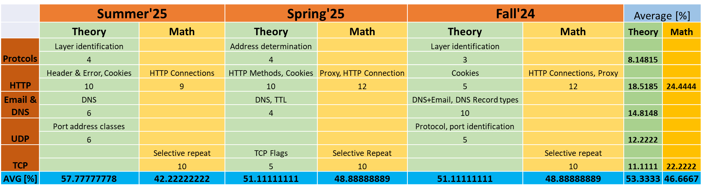
Analysis of Previous Semesters' Questions
Full Marks: 45

Slide 19
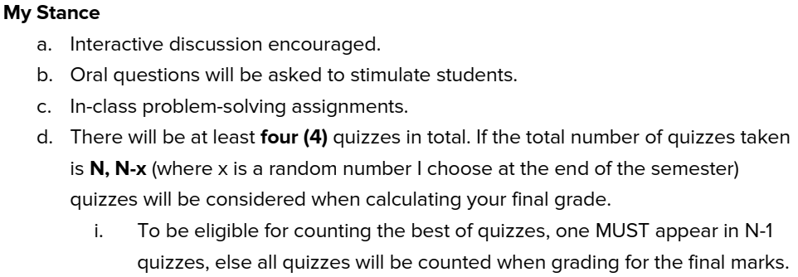

Slide 20
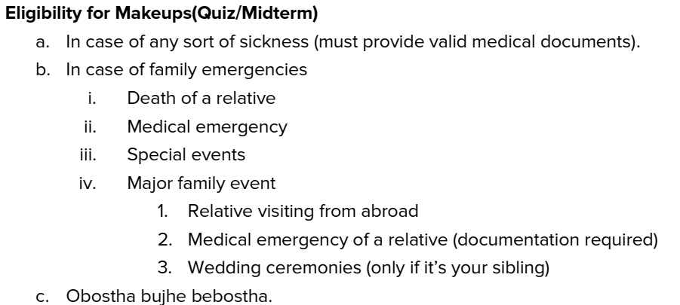

Slide 21
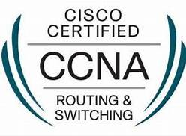

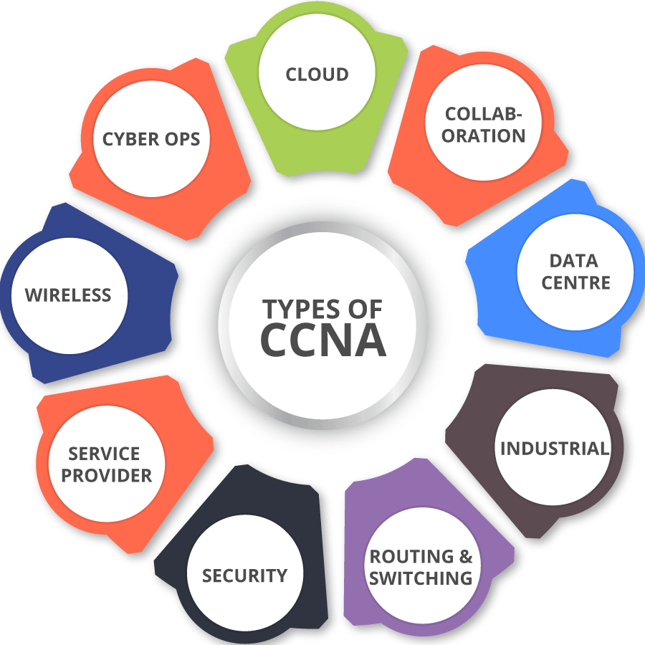
CCNA
Cisco Certified Network Associate (CCNA)
A popular industry certification program in computer networking developed by Cisco Systems.
Cisco created the CCNA to recognize basic competency in the installation and support of medium-sized networks.
Globally recognized and it is respected by most companies across the globe.
This certificate, not only enhances the career growth opportunities, but also provide the candidates with a higher pay scale.

Slide 22
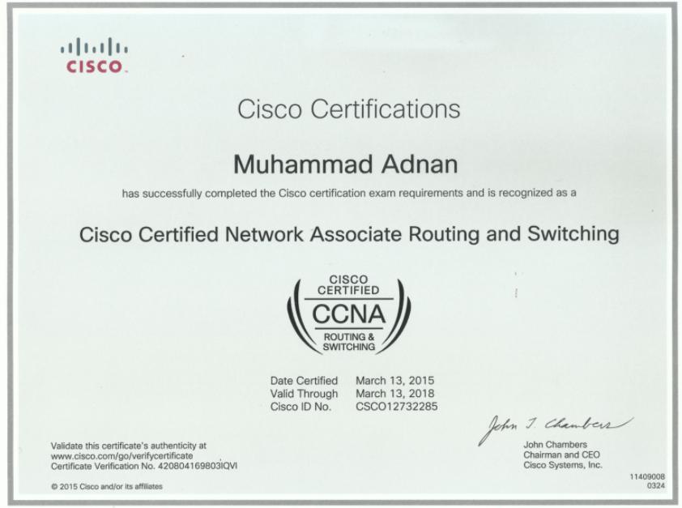
CCNA Certification
Eligibility Criteria
To receive the CCNA certificate an individual must have passed the following Exam:
  Combined CCNA Exam (200-301) (Cost $300) (120 mins)
.
Validity 3 years
Exam must be given at a Pearson VUE center

Slide 23
CCNA Content
CCNA Module | Name of Module | Aligned with which Bracu Courses
CCNA 1 v7 | Introduction to Networks | CSE421
CCNA2 v7 | Routing, Switching & Wireless Essentials | CSE490 (WAN Routing)
CCNA3 v7 | Enterprise Networking, Security & Automation | CSE490 (WAN Routing)

Slide 24
For Queries be present in the live sessions.
Or post your queries in the discussion board
Thank you

